Slide 1
Introduction
to
Postmodernism
Semiotics

Slide 2

Ferdinand de Sausurre
Swiss (1857 - 1913)
Structuralism
Notes:
The next term we are going to study comes from the Swiss linguist Ferdinand de Sausurre. His particular branch of language study became know as structuralism, from it's interest in studying the relationships between smaller parts within a larger, overarching system or structure.

Slide 3
semiotics
SIGN
signifier | signified
Notes:
The particular focus of his that postmodernism is most concerned with is semiotics, or the study of signs. Sausurre said all language could be broken down into signs, that is chunks of meaning, and that each of these signs contained both a signifier and a signified.

Slide 4
sign: WINE
signifier: the letters: w, i, n, & e the sound of the word “wine” | signified: what you think of when you read or hear or the word “wine”
Notes:
Let's take an example: I'm going to say the word "wine"

Slide 5
sign: WINE
signifier: the letters: w, i, n, & e the sound of the word “wine” | signified: what you think of when you read or hear or the word “wine”
Notes:
In this case the signifier is either the sound of the word wine when you hear the word, or the letters that make up the word when you read it.

Slide 6
sign: WINE
signifier: the letters: w, i, n, & e the sound of the word “wine” | signified: what you think of when you read or hear or the word “wine”
Notes:
And the signified is what you think of when you hear or read the word. Together they create the meaning, the sign, that is communicated by the word wine.

Slide 7
What does a grape say
when you step on it?
Notes:
Let me elaborate by telling you a joke: What does a grape say when you step on it?

Slide 8
Nothing, it just gives out
a little whine.
Notes:
Nothing it just gives out a little whine.

Slide 9
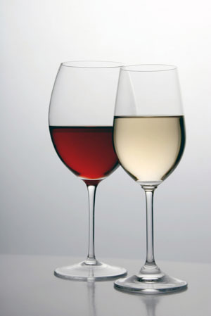

sign:
signifier: the sound of the word “whine” | signified: “wine”
Notes:
This kind of joke is a pun, and puns intentionally confuse two words which are either spelled or sound the same. When the wires get crossed between the signifier and the signified, we end up with a faulty sign. Normally this kind of miscommunication is just frustrating, but when it's a joke, and we 'get it' this confusion can be funny.

Slide 10
-Who is the mother of rice?
-Flower.
wha?-
-Because, shelled peanuts.
Notes:
Here's another joke, hilarious, right? What, you don't get it?

Slide 11
米的媽媽是誰？
是花。
啊？
因為，花生米。
Notes:
The reason you don't get it is that it has been translated from Chinese.米的媽媽是誰？是花。啊？因為，花生米。

Slide 12
花生米 shelled peanuts
花 huā - flower
生 shēng - to give birth
米 mǐ - rice
Notes:
The three characters that when put together mean "shelled peanuts" in Chinese, if read as a sentence, could mean something like "flower gives birth to rice", so therefore the joke is that flower is the mother of rice. Sausurre said that the relation between signifier and signified is arbitrary. We may say "peanut" or "wine" but nothing is signified if you say these things to someone who doesn't speak English.

Slide 13
THE CONCEPT OF “WINE”
“wine” | wine vin vino 葡萄酒 نبيذ 포도주
Notes:
Now this is why semiotics is particularly interesting to visual artists, because we have an advantage here. When I show you a picture of wine, it doesn't matter what languages you speak, the same meaning will come across. Wherever you are in the world, as long as you know what wine looks like, a picture of wine will still work as a signifier for the concept of wine.

